Slide 1

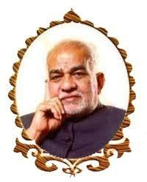
BVRIT HYDERABAD College of Engineering for Women Department of Computer Science & Engineering
Retina Gray Scale Image Perception using Deep Learning
29 April, 2023
Under the Guidance of :
Name: Ms. Shanmuga Sundari
Designation: Assistant Professor
Team No : 04
N. Anjali : 19WH1A05A7
P. Harshini Reddy : 19WH1A05A3
A. Dhanuhya : 19WH1A0562

Slide 2
List of Contents
Abstract
Introduction
Objective
Literature Survey
Existing system
Proposed System
Architecture
Methodology
Dataset
Evaluation Metrics
Societal impact
Conclusion
References

Slide 3
ABSTRACT
Millions of people in the world are affected by ocular fundus diseases such as diabetic retinopathy, age-related macular degeneration, glaucoma, retinal detachment, and fundus tumors, without accurate diagnoses and timely appropriate treatment, these fundus diseases can lead to irreversible blurred vision, or even blindness.
Segmentation of retinal blood vessels is considered as an effective technique for diagnosing these diseases. We are aiming to solve the problems of serious segmentation errors of eyes by using network architectures, like semantic pixel-wise segmentation (SegNet) and U-net. The accurate segmentation of retinal blood vessels in fundus is of great practical significance to help doctors diagnose fundus diseases.

Slide 4
INTRODUCTION
As a vital part of the eye, the retina plays a significant role in the human body. Humans rely on their eyes for 80% of the ways they receive information from the outside world. The quality of human eyesight is significantly influenced by the retina.
Clinical medicine currently relies on ophthalmological tools and medical imaging technology for the diagnosis and treatment of individuals with retinal injury or detached blindness.

Slide 5
INTRODUCTION(cont..)
The retina produced by the current imaging technology has significant flaws, which makes it difficult for the medical treatment and perform attentive observation and correct judgment. Therefore we are going to use some CNN Algorithms.
These algorithms will help the doctors by providing the gray scale image of the retina image in which it has a clear vision of optic nerves, blood vessels of the eye which helps in better understanding of the eye for the doctors.Then from the image doctors can treat the patients with better analaysis.

Slide 6
OBJECTIVE
Our main objective of the project is to help the doctors to analyze retinal images and get a clear knowledge about the patients conditions. This facilitates the work of medical professionals by offering a more accurate understanding of the blood vessels, optic nerves of an eye.

Slide 7
LITERATURE SURVEY
S.No | Title of the paper | Author(s) & Journal Details | Description/Interpretation
1 | Harnessing Multi-View Perspective of Light Fields for Low-Light Imaging | Mohit Lamba , Kranthi Kumar Rachavarapu , and Kaushik Mitra, IEEE TRANSACTIONS ON IMAGE PROCESSING, VOL. 30, 2021 | Proposed System : A deep neural network L3Fnet for Low-Light Light Field (L3F) restoration, which not only performs visual enhancement of each LF view but also preserves the epipolar geometry across views Future Work : An interesting direction would be to explore which camera is more suited for low-light reconstruction: a single-frame DSLR camera or a Light Field camera.
2 | Raindrop Removal With Light Field Image Using Image Inpainting | TAO YANG, XIAOFEI CHANG , HANG SU3,NATHAN CROMBEZ, YASSINE RUICHEK TOMAS KRAJNIK5 , AND ZHI YAN, April 6, 2020. | Proposed System: A method that removes raindrops with light field image using image inpainting. The depth map generated from the light field image was used to detect raindrop regions, which were then expressed as a binary mask. Future Work : Combining use of our light field dataset with the EU long-term dataset for long-term autonomy of vehicles
3 | A Double-Deep Spatio-Angular Learning Framework for Light Field-Based Face Recognition | Alireza Sepas-Moghaddam , Mohammad A. Haque, Paulo Lobato Correia ,Kamal Nasrollahi, Thomas B. Moeslund, and Fernando Pereira , VOL. 30, NO. 12, DECEMBER 2020 | Proposed System: This paper proposes a double-deep spatio-angular learning framework for light field-based face recognition, which is able to model both the intra-view/spatial and inter-view/angular information using two deep networks in sequence.. Future Work : An extension of the LSTM for spatio-angular visual recognition tasks, further exploiting the additional angular information, will be considered as future work.
4 | Deep Light Field Super-Resolution Using Frequency Domain Analysis and Semantic Prior | Yeyao Chen ,Gangyi Jiang , Zhidi Jiang , Mei Yu , Yo-Sung Ho, IEEE TRANSACTIONS ON MULTIMEDIA, VOL. 24, 2022 | Propopsed System : This proposes a new LF super-resolution method using frequency domain analysis and semantic prior, which designs a two-stage learning framework to enhance the spatial and angular resolutions of LFI. Future Work : In the future, we will study the influence of different transforms on LF super-resolution, and extend the proposed method to more LF restoration tasks

Slide 8
LITERATURE SURVEY
S.No | Title of the paper | Author(s) & Journal Details | Description/Interpretation
5 | CapsField: Light Field-Based Face and Expression Recognition in the Wild Using Capsule Routing | Alireza Sepas-Moghaddam , Ali Etemad , Fernando Pereira ,Paulo Lobato Correia, IEEE TRANSACTIONS ON IMAGE PROCESSING, VOL. 30, 2021 | Proposed System : A new deep face and expression recognition solution, called CapsField, based on a CNN and an additional capsule network that utilizes dynamic routing to learn hierarchical relations between capsules. Future Work : Have to study the influence of different transforms on LF super-resolution, and extend the proposed method to more LF restoration tasks.
6 | Light Field Image Super-Resolution via Mutual Attention Guidance | ZIJIAN WANG AND YAO LU, September 24, 2021 | Proposed System : We propose a Mutual Attention Guidance Network (namely LF-MAGNet) for LFSR. LF-MAGNet is mainly constructed by our proposed MAGs in a cascade manner. Each MAG is built on CAG and SAG to conduct feature alignment between the center-view and surrounding-view features. Future Work : We want to propose a transformer-based feature alignment approach to fully utilize different views of features from the light field image in future work
7 | AIFNet: All-in-Focus Image Restoration Network Using a Light Field-Based Dataset | Lingyan Ruan , Bin Chen , Jizhou Li , and Miu-Ling Lam, IEEE TRANSACTIONS ON COMPUTATIONAL IMAGING, VOL. 7, 2021 | Proposed System : This proposes a novel convolutional neural network architecture AIFNet for removing spatially-varying defocus blur from a single defocused image. Future Work : We hope this work will also inspire new research and applications of light fields in addressing real world challenges
8 | An Off-Axis Flight Vision Display System Design Using Machine Learning | Shan Mao , Zhenbo Ren, and Jianlin Zhao, IEEE PHOTONICS JOURNAL, VOL. 14, NO. 2, APRIL 2022 | Proposed System : This proposes an off-axis flight vision display system design with a free-form surface using machine learning to simulate the visual distance variation during take-off and landing training for pilots. Future Work : We will focus on more diversified theories and methods for intelligent design.

Slide 9
LITERATURE SURVEY
S.No | Title of the paper | Author(s) & Journal Details | Description/Interpretation
9 | Deep Learning for Unsupervised Anomaly Localization in Industrial Images: A Survey | Xian Tao, Xinyi Gong , Xin Zhang , Shaohua Yan, VOL. 71, 2022 | Proposed System: Used to help researchers by comprehensively surveying recent achievements in unsupervised AL in industrial images using deep learning. Future Work : We anticipate that this study not only improves an academic understanding of industrial AL but also encourages future research efforts.
10 | The Recognition Framework of Deep Kernel Learning for Enclosed Remote Sensing Objects | LONG SUN, JIE CHEN,DAZHENG FENG,MENGDAO XING ,July 13, 2021 | Proposed System : It proposes a remote sensing image target recognition method based on deep saliency kernel learning analysis that uses target region extraction based on the visual saliency mechanism and implements a nonlinear deep kernel learning saliency feature analysis method to realize target extraction and recognition. Future Work : To improve the target classification accuracy.
11 | Deep Light Field Spatial Super-Resolution Using Heterogeneous Imaging | Yeyao Chen, Gangyi Jiang, Mei Yu, Haiyong Xu, Yo-Sung Ho,2022 | Proposed System : We propose a new deep learning-based light field (LF) spatial super-resolution method using heterogeneous imaging. By incorporating a high-resolution (HR) traditional camera into the LF camera imaging, this method can enhance the spatial resolution of the LF image with 2D HR information and restore sufficient texture and detail. Future Work : In the future, we will consider more complicated degradation models to further improve the generalization ability of the proposed method and boost the performance on wide-baseline LF images.
12 | Unrolling Graph Total Variation For Light Field Image Denoising | Rino Yoshida, Kazuya Kodama, Huy Vu, Gene Cheung, Takayuki Hamamoto,2022 | Proposed System : To denoise a 4D LF image composed of many SAIs from different viewpoints, we propose a hybrid scheme that combines the interpretable merit of graph-model-based methods with learning power of DL-based methods. Future Work : We plan to accelerate our proposed method based on graph filter approximation , while retaining the framework’s effectiveness and robustness

Slide 10
EXISTING SYSTEM
The existing system have combined the light field imaging technology with reconstruction algorithms like nearest neighbors interpolation, linear interpolation and optimization algorithm and got the accuracies as 68.15%, 56.397%, 34.257% respectively.

Slide 11
PROPOSED SYSTEM
We have implemented the U-Net and trying to implement Seg-Net Algorithm which are most widely used for bio-medical images.

Slide 12
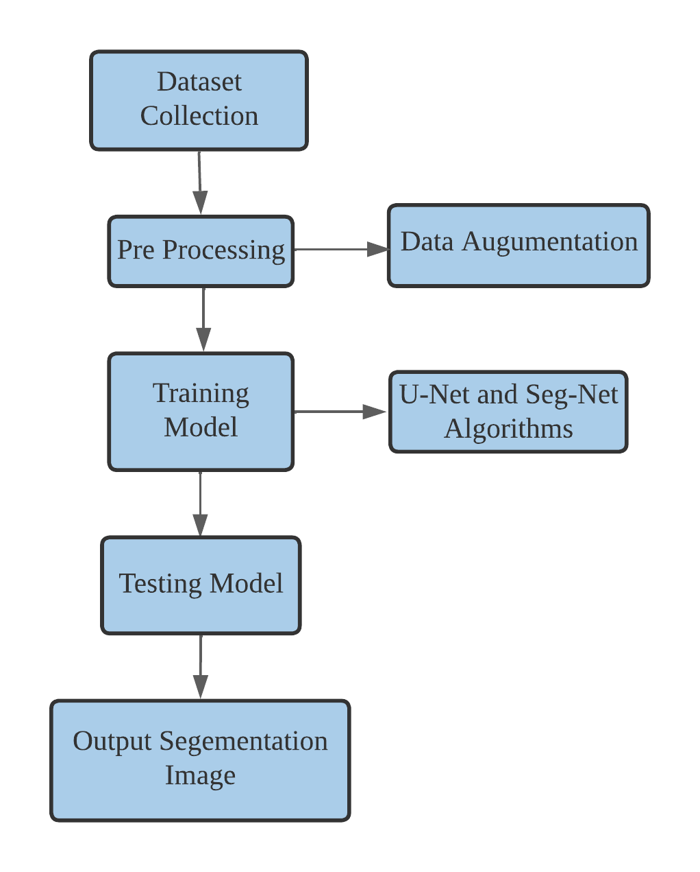
ARCHITECTURE

Slide 13
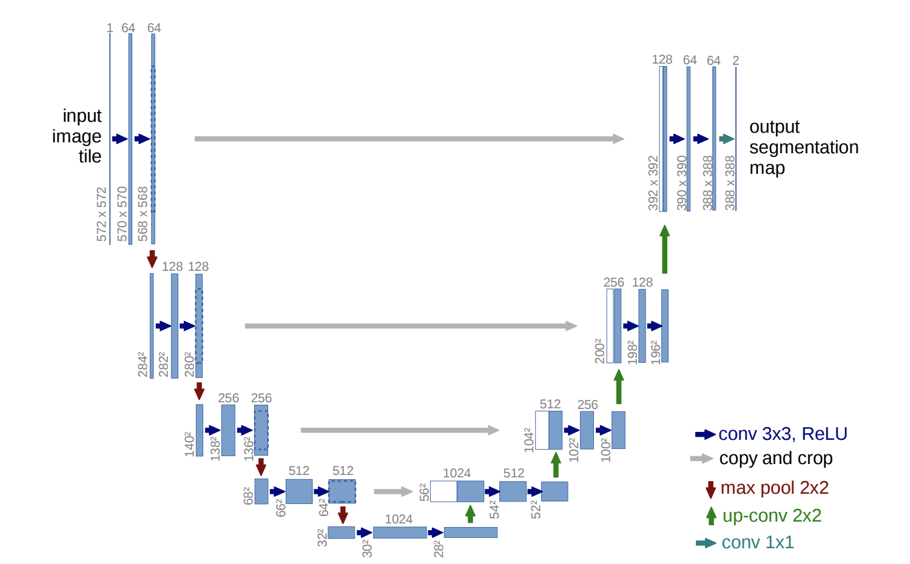
METHODOLOGY
U-Net Architecture

Slide 14
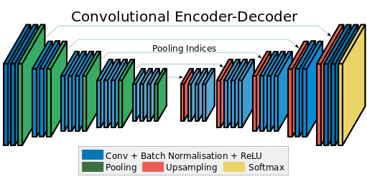
METHODOLOGY(Cont..)
Seg-Net Architecture

Slide 15
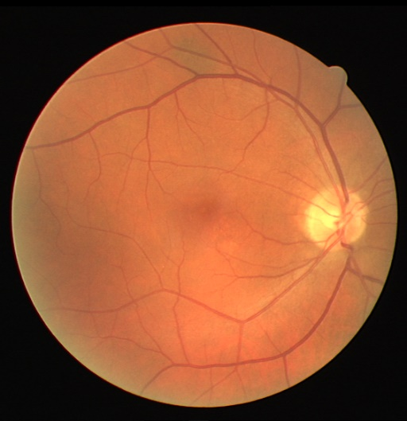
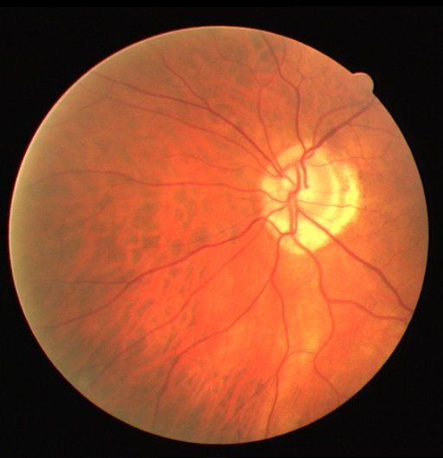
DATASET
Name of the Dataset - DRIVE
Dataset type : Images
No. of. Images : 1,90,000 patches per image
Sample Images

Slide 16
EVALUATION METRICS
Precision Score
IOU Score
ROC Curve

Slide 17
SOCIETAL IMPACT
Our project improves image visualization for clinical retina examination by doctors, enabling them to treat patients with greater accuracy.
This facilitates the doctors quick and accurate analysis of patient reports.

Slide 18
CONCLUSION
We have implemented U-Net Algorithm and we got the ROC curve of accuracy 92%. We are going to train the model using Seg-Net Algorithm.

Slide 19
REFERENCES
[1] Lingyan Ruan , Bin Chen , Jizhou Li , and Miu-Ling Lam “AIFNet: All-in-Focus Image Restoration Network Using a Light Field-Based Dataset”, IEEE TRANSACTIONS ON COMPUTATIONAL IMAGING, VOL. 7, 2021
[2] Hyunsuk Ko , Member, IEEE, Dae Yeol Lee, Seunghyun Cho, and Alan C. Bovik, Fellow, IEEE “Quality Prediction on Deep Generative Images” IEEE TRANSACTIONS ON IMAGE PROCESSING, VOL. 29, 2020
[3] Shan Mao , Zhenbo Ren, and Jianlin Zhao “An Off-Axis Flight Vision Display System Design Using Machine Learning” IEEE PHOTONICS JOURNAL, VOL. 14, NO. 2, APRIL 2022
[4] Xian Tao , Member, IEEE, Xinyi Gong , Xin Zhang , Shaohua Yan , and Chandranath Adak , Senior Member, IEEE “Deep Learning for Unsupervised Anomaly Localization in Industrial Images: A Survey”, IEEE TRANSACTIONS ON, VOL. 71, 2022
[5] LONG SUN1,2,3, JIE CHEN 3,4, (Member, IEEE), DAZHENG FENG1,2, (Member, IEEE), AND MENGDAO XING 1,2, (Fellow, IEEE) “The Recognition Framework of Deep Kernel Learning for Enclosed Remote Sensing Objects”, date of current version July 13, 2021.
[6] Yeyao Chen, Graduate Student Member, IEEE, Gangyi Jiang, Senior Member, IEEE, Mei Yu, Haiyong Xu, Yo-Sung Ho, Fellow, IEEE, “ Deep Light Field Spatial Super-Resolution Using Heterogeneous Imaging”,2022.
[7] Rino Yoshida , Kazuya Kodama, Huy Vu,Gene Cheung, Takayuki Hamamoto “UNROLLING GRAPH TOTAL VARIATION FOR LIGHT FIELD IMAGE DENOISING”,2022.
[8] MD RASHED RAHMAN 1 , (Graduate Student Member, IEEE), T. V. SETHURAMAN2 , MARCO GRUTESER3 , KRISTIN J. DANA4 , (Member, IEEE), SHUBHAM JAIN5 , NARAYAN B. MANDAYAM 4 , (Fellow, IEEE), AND ASHWIN ASHOK 1 , (Senior Member, IEEE) “Camera-Based Light Emitter Localization Using Correlation of Optical Pilot Sequences “,date of current version March 9, 2022.

Slide 20
REFERENCES
[9] Juan Casavílca Silva , Muhammad Saadi , Lunchakorn Wuttisittikulkij , Member, IEEE, Davi Ribeiro Militani, Renata Lopes Rosa, Demóstenes Zegarra Rodríguez , Senior Member, IEEE, and Sattam Al Otaibi ,“Light-Field Imaging Reconstruction Using Deep Learning Enabling Intelligent Autonomous Transportation System”, IEEE TRANSACTIONS ON INTELLIGENT TRANSPORTATION SYSTEMS, VOL. 23, NO. 2, FEBRUARY 2022
[10] Mohit Lamba , Graduate Student Member, IEEE, Kranthi Kumar Rachavarapu , and Kaushik Mitra , Member, IEEE, “Harnessing Multi-View Perspective of Light Fields for Low-Light Imaging”, IEEE TRANSACTIONS ON IMAGE PROCESSING, VOL. 30, 2021
[11] TAO YANG1 , XIAOFEI CHANG 2 , HANG SU3,4, NATHAN CROMBEZ 1 , YASSINE RUICHEK 1 , (Senior Member, IEEE), TOMAS KRAJNIK5 , AND ZHI YAN , “Raindrop Removal With Light Field Image Using Image Inpainting”, date of current version April 6, 2020
[12] Alireza Sepas-Moghaddam , Student Member, IEEE, Mohammad A. Haque, Member, IEEE, Paulo Lobato Correia , Senior Member, IEEE, Kamal Nasrollahi, Member, IEEE, Thomas B. Moeslund, and Fernando Pereira ,“A Double-Deep Spatio-Angular Learning Framework for Light Field-Based Face Recognition”, IEEE TRANSACTIONS ON CIRCUITS AND SYSTEMS FOR VIDEO TECHNOLOGY, VOL. 30, NO. 12, DECEMBER 2020
[13] Yeyao Chen , Graduate Student Member, IEEE, Gangyi Jiang , Senior Member, IEEE, Zhidi Jiang , Mei Yu , and Yo-Sung Ho , Fellow, IEEE, “Deep Light Field Super-Resolution Using Frequency Domain Analysis and Semantic Prior”, IEEE TRANSACTIONS ON MULTIMEDIA, VOL. 24, 2022
[14] Alireza Sepas-Moghaddam , Member, IEEE, Ali Etemad , Senior Member, IEEE, Fernando Pereira , Fellow, IEEE, and Paulo Lobato Correia , Senior Member, IEEE, “CapsField: Light Field-Based Face and Expression Recognition in the Wild Using Capsule Routing”, IEEE TRANSACTIONS ON IMAGE PROCESSING, VOL. 30, 2021
[15] ZIJIAN WANG AND YAO LU, (Member, IEEE) “Light Field Image Super-Resolution via Mutual Attention Guidance”, date of publication September 14, 2021

Slide 21
THANK YOU

